Slide 1
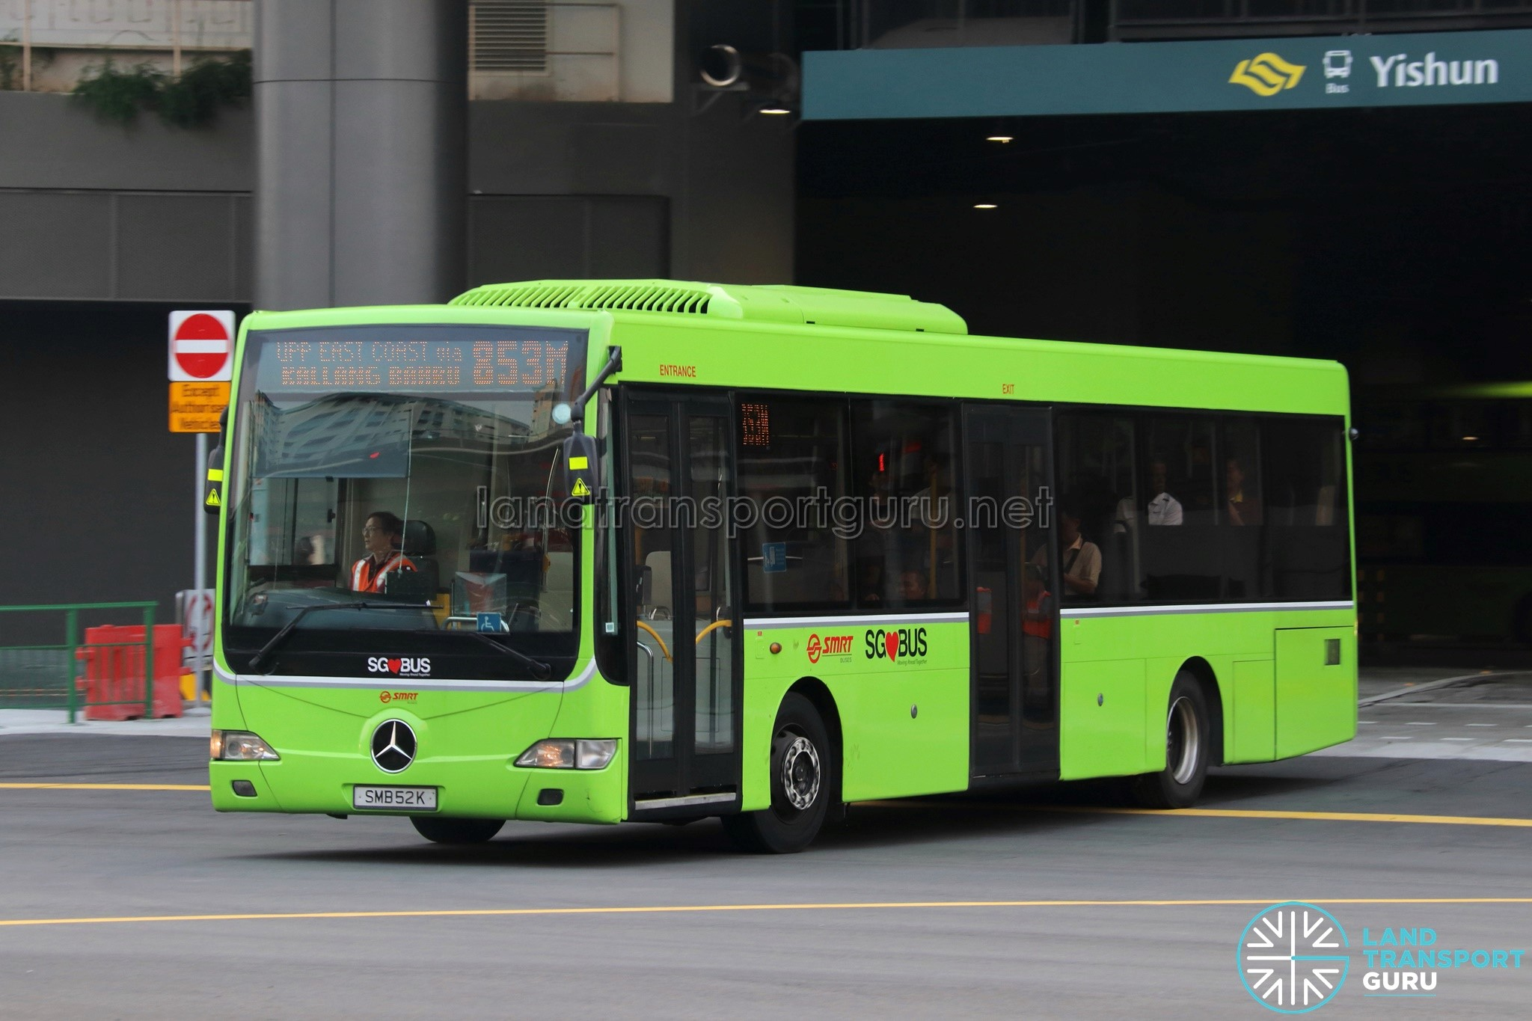
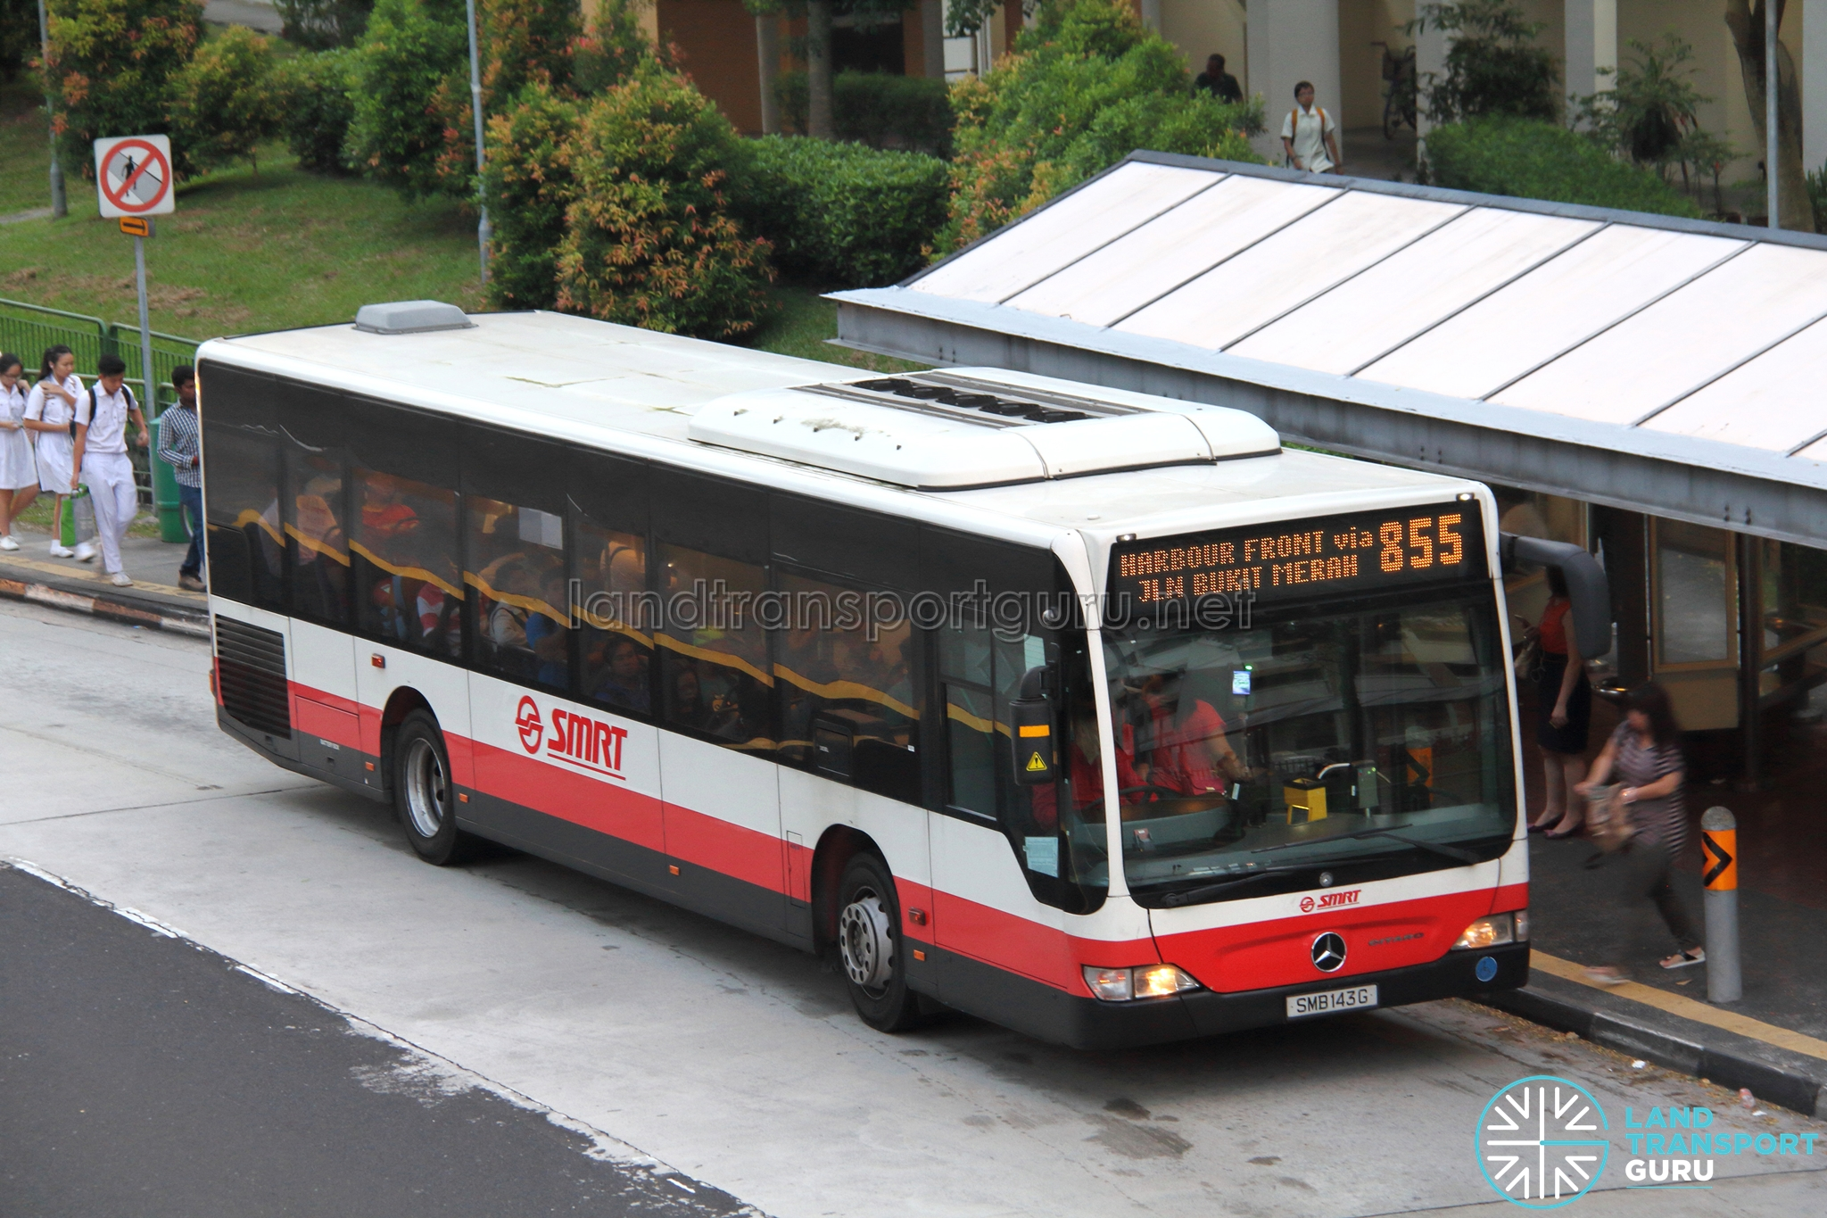
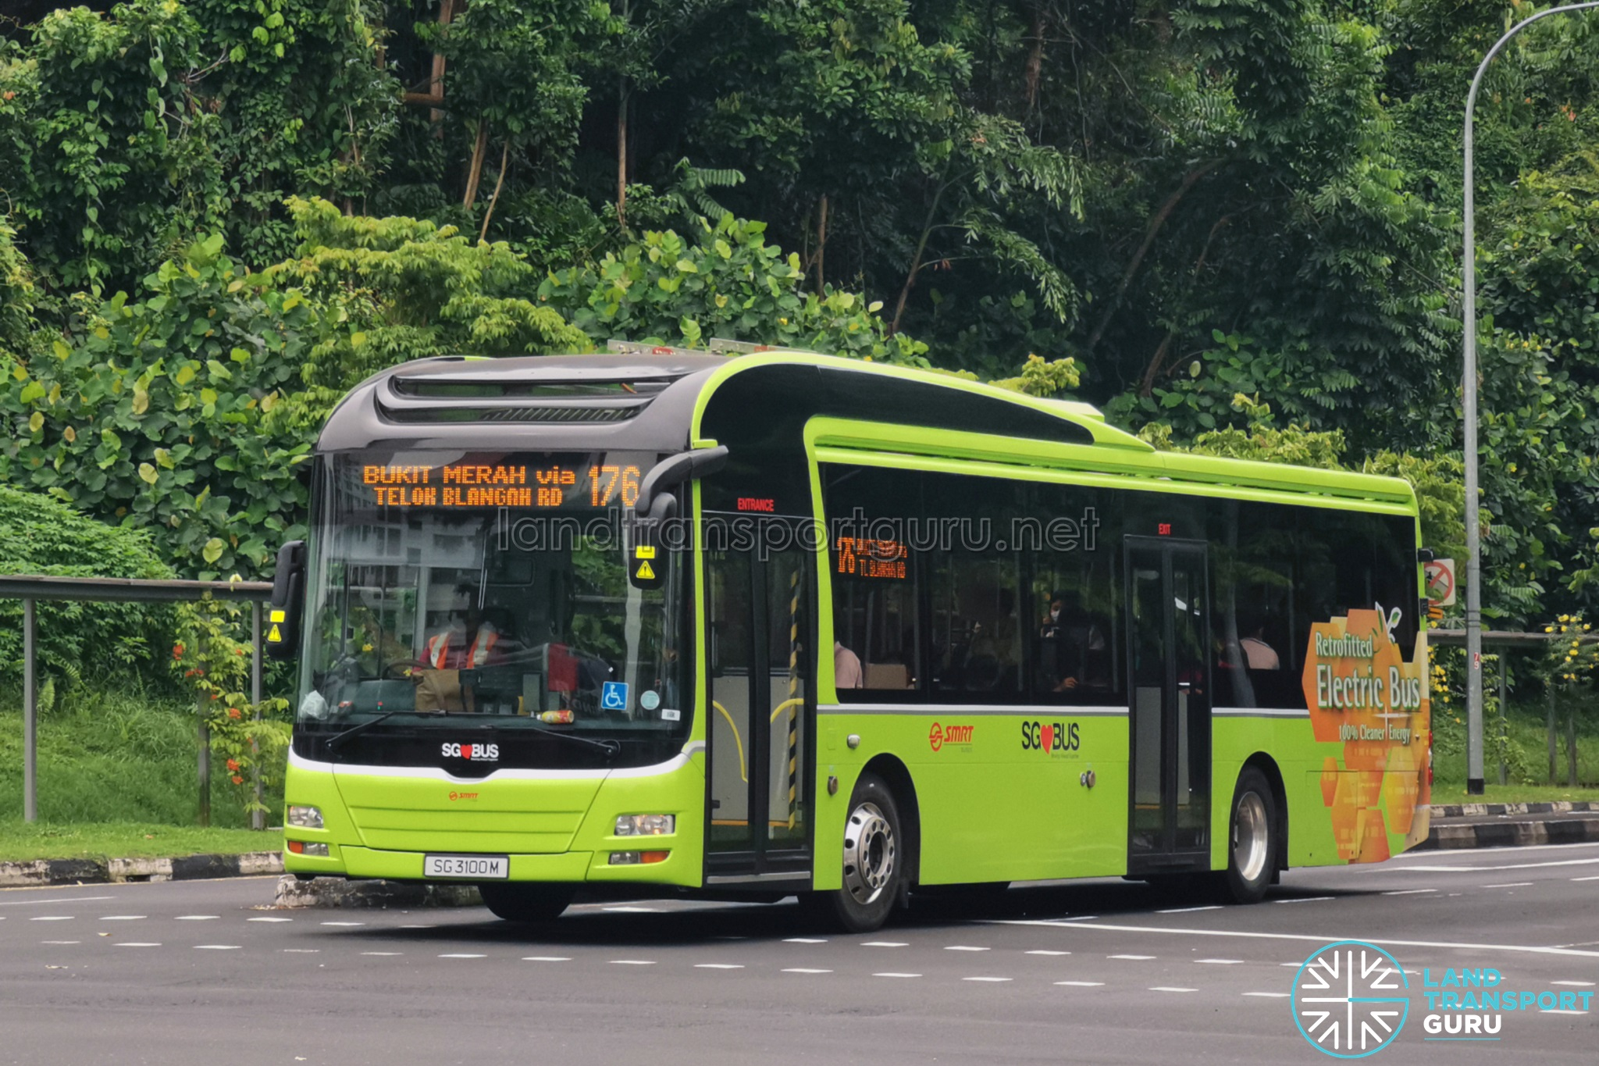
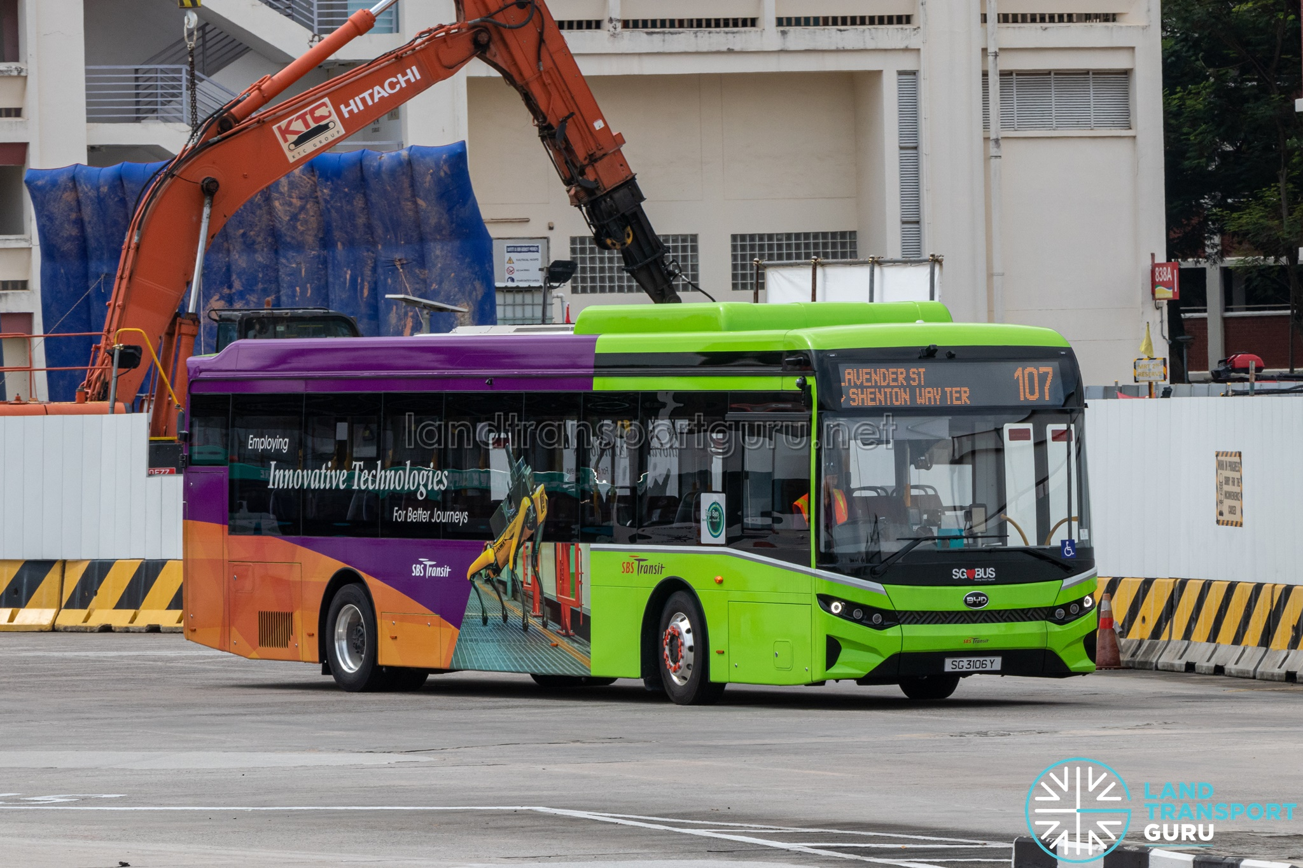
The SG Bus Tips and Tricks for tourists
Talking on how to use Singapore’s EXCELLENT bus network

Slide 2
Rules and regulations of the Buses in SG
Do not bring in durians in the bus
Do not smoke in the bus
Do not eat or drink in the bus (including water)
Do not bring super-big luggages on board – $500 fine (do not exceed 90cm x 60cm x 30cm)
Do not bring in bicycles that are bigger than 120cm x 70cm x 40cm-$500 fine

Slide 3
SG Bus operating hours
Buses typically operate from 5:30 AM to 12:30 AM.
Exact operating hours and frequency depend on the specific route.
This info is usually displayed at the bus stop.
For late-night travel, some operators provide special services, including:
  Night buses running on Fridays, Saturdays, and public holidays
  These usually operate from around 11:30 PM to 2:00 AM.

Slide 4
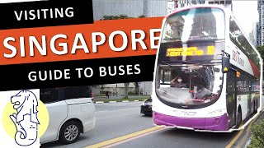
The video that can explain how to take the bus (I will cover in more detail later)

Slide 5
Pay for your trip
Visa or Mastercard or NETS Contactless Bank Cards or American Express (credit/debit cards) (foreign ones work too)(recommended option)
EZ-Link Cards (price $10 $5 credit) (buy at any Simply Go Ticket Office click for locations)
Mobile Wallets Apple Pay, Google Pay, Samsung Pay, Fitbit Pay, Garmin Pay, Singtel Dash (foreign ones work too) (recommended option)
Singapore Tourist Pass $17/$24/$29 1 – 3 Days Duration Unlimited Rides* on Public Transport (there is also a plus option click to see)(click to see buy locations)
NETS Prepaid Cards (buy at NETS Customer Service Centre click here for directions)
NETS FlashPay Cards (for more information click here)
Cash (unrecomended)(Costs more)(NO CHANGE)
Click here to find out more for Paying for your trip.

Slide 6
2. Plan your route
Bus stop signs provide helpful information:
Show a list of buses that stop there.
Show the next stops for each bus after that stop.
Useful if you know the name of your destination stop.
(Continued on the next slide)

Slide 7
2. Plan your route
Additional info on the sign:
May include the name of the road the stop is on (helpful if you don’t know the stop name).
Shows if other buses also go to your destination (another bus might arrive earlier).
Shows fare info if you’re paying by cash.
Does not include a map.
(Continued on the next slide)

Slide 8
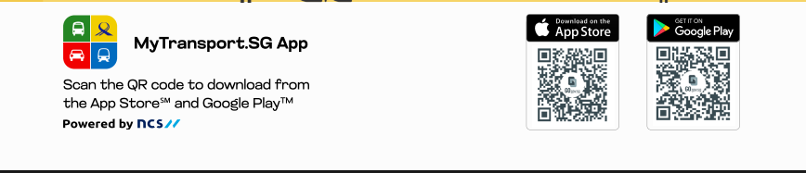
2. Plan your route
For directions and bus arrivals:
Use Google Maps for step-by-step directions and alternate routes.
Use the MyTransport.SG app or website to:
  Check when the next bus arrives.
  Bus Services
  Etc… for more info click here
  Available on:
    Android: https://tinyurl.com/mytransportsgappandroid
    iOS: https://tinyurl.com/mytransportsgappios
(Continued on the next slide)

Slide 9
2. Plan your route
For directions and bus arrivals (also):
Use the Singabus app (my personal preference) to:
  Check when the next bus arrives.
  Remind you when your stop is near
  Runs on older devices
  Available on:
    Android: https://tinyurl.com/singabusappandroid
    iOS: https://tinyurl.com/singabusappios

Slide 10
2. Plan your route
Most buses arrive every 2–15 minutes.
Some bus numbers have suffixes or prefixes.
(Continued on the next slide)

Slide 11
2. Plan your route
🔹 A, B, C — Short Trip Services
Only cover part of the main route.
Serve busy sections during:
  Peak hours
  Late nights
  Weekends
Examples:
  138A – Singapore Zoo (attraction)
  962C – Rare use of the C suffix
(Continued on the next slide)

Slide 12
2. Plan your route
🔹 E, e — Express Services
‘E’ (uppercase): Peak-hour express routes (e.g. 850E, 951E).
‘e’ (lowercase): Limited-stop express routes, often via expressways (e.g. 12e, 89e).
Skips stops for faster travel and charges express fares.(may skip your stop check the signs at bus stops to confirm)
(Continued on the next slide)

Slide 13
2. Plan your route
🔹 G, W — Directional Loop Services
G: Green Plate – Clockwise
W: White Plate – Counter-clockwise
Used on loop services like 410G/W or 382G/W.
Based on old color-coded signs now shown as suffixes on buses.
(Continued on the next slide)

Slide 14
2. Plan your route
🔹 M, X — Modified / Variant Routes
‘M’: Modified version of parent route (e.g. 123M, 181M).
  May run full-day, peak-only, or on weekends.
‘X’: Express Feeder Variant under LTA’s 2024 plan.
  Skips stops for faster trips (e.g. 298X, 21X, 979X).
(Continued on the next slide)

Slide 15
2. Plan your route
🔹 T — Terminating Services
Bus ends its trip at the interchange (does not continue on the loop).
Used for two-part feeder loops (e.g. 291T, 911T, 36T).
Standardized across all operators in 2021.
(Continued on the next slide)

Slide 16
2. Plan your route
🔹 EB, GA, TT, WT — Employee Services
Used by operators to transport staff. (Do NOT board on these buses)
Prefixes:
  EB – SBS Transit
  WT – SMRT
  TT – Tower Transit
  GA – Go-Ahead Singapore
(It finally ends lol)

Slide 17
3. Ride the bus
When the bus arrives, tap your card on the card reader and board.
Your fare is based on distance, and it’s calculated at the end of your journey.
You can change buses, and the fare will still be based on total distance.
You may sit anywhere, but:
  Some seats are reserved for people who need them more (e.g. elderly, disabled).
  Some buses have an upper deck where you can also sit.
When your stop is next, press the red stop button to signal the driver.
  You can check the stop name on the screen inside the bus.
Don’t forget to tap your card out when you exit the bus, so your fare is charged correctly.

Slide 18
4. The price of The SG Bus
Usually just about S$1-S$2 not too much.
May not show price for ride.

Slide 19
5. Good things to note
Some express buses do not have an e in them they are the 5XX buses
There are also City Direct Services which are like express buses but only go to the city they are the 6XX buses

Slide 20
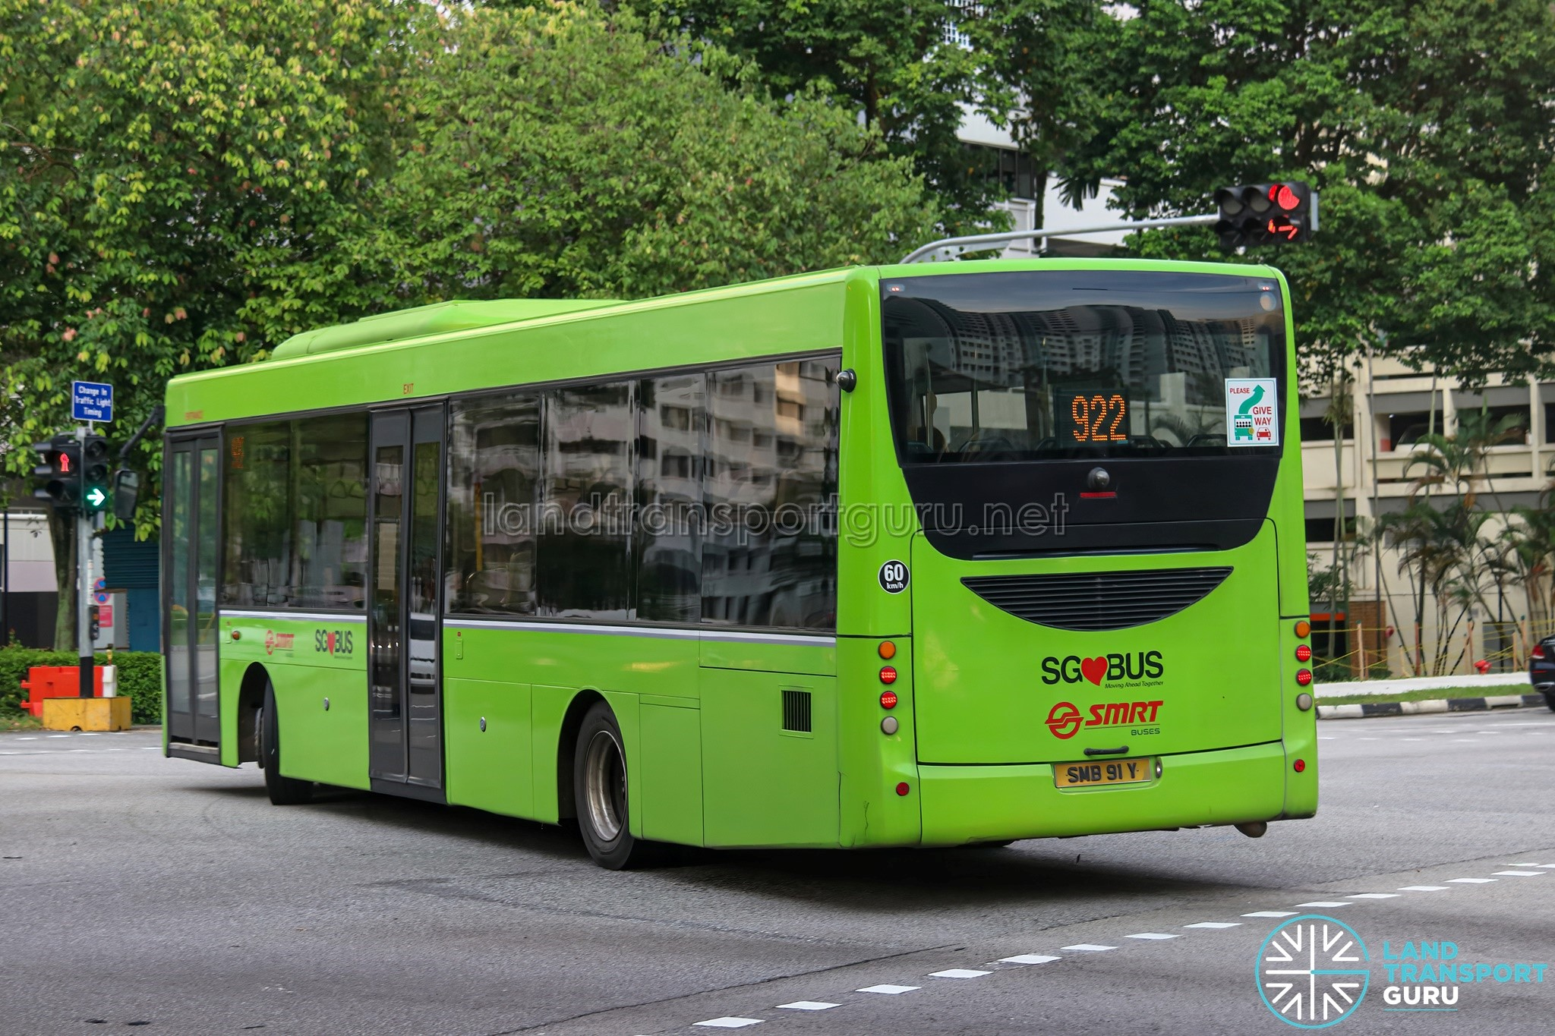

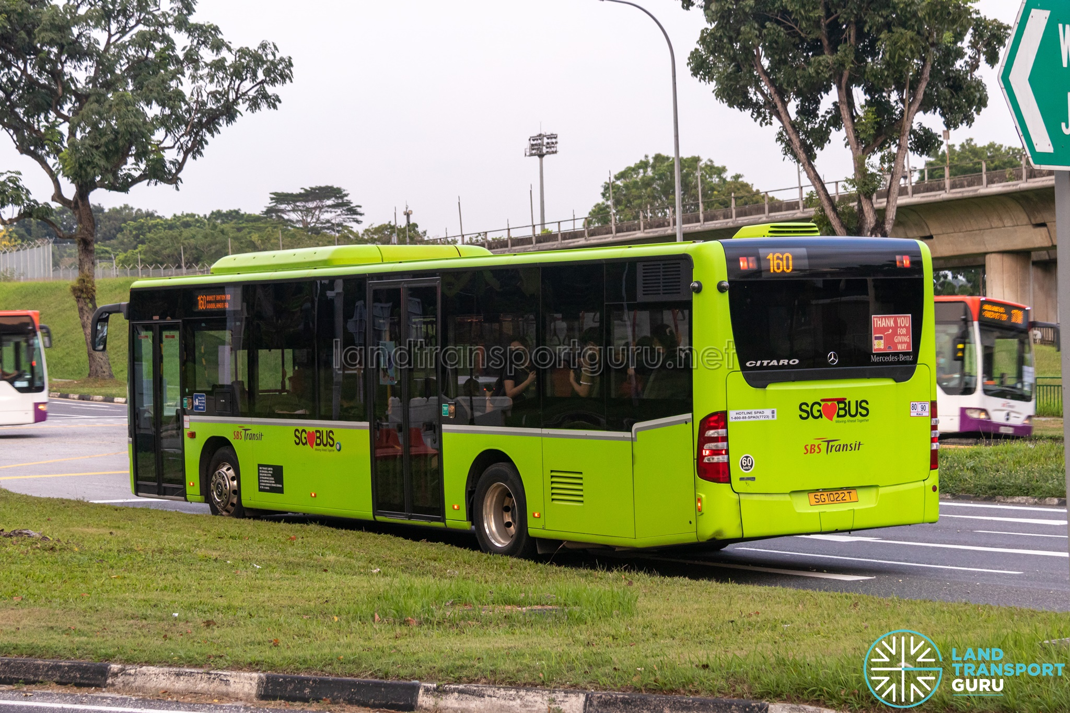
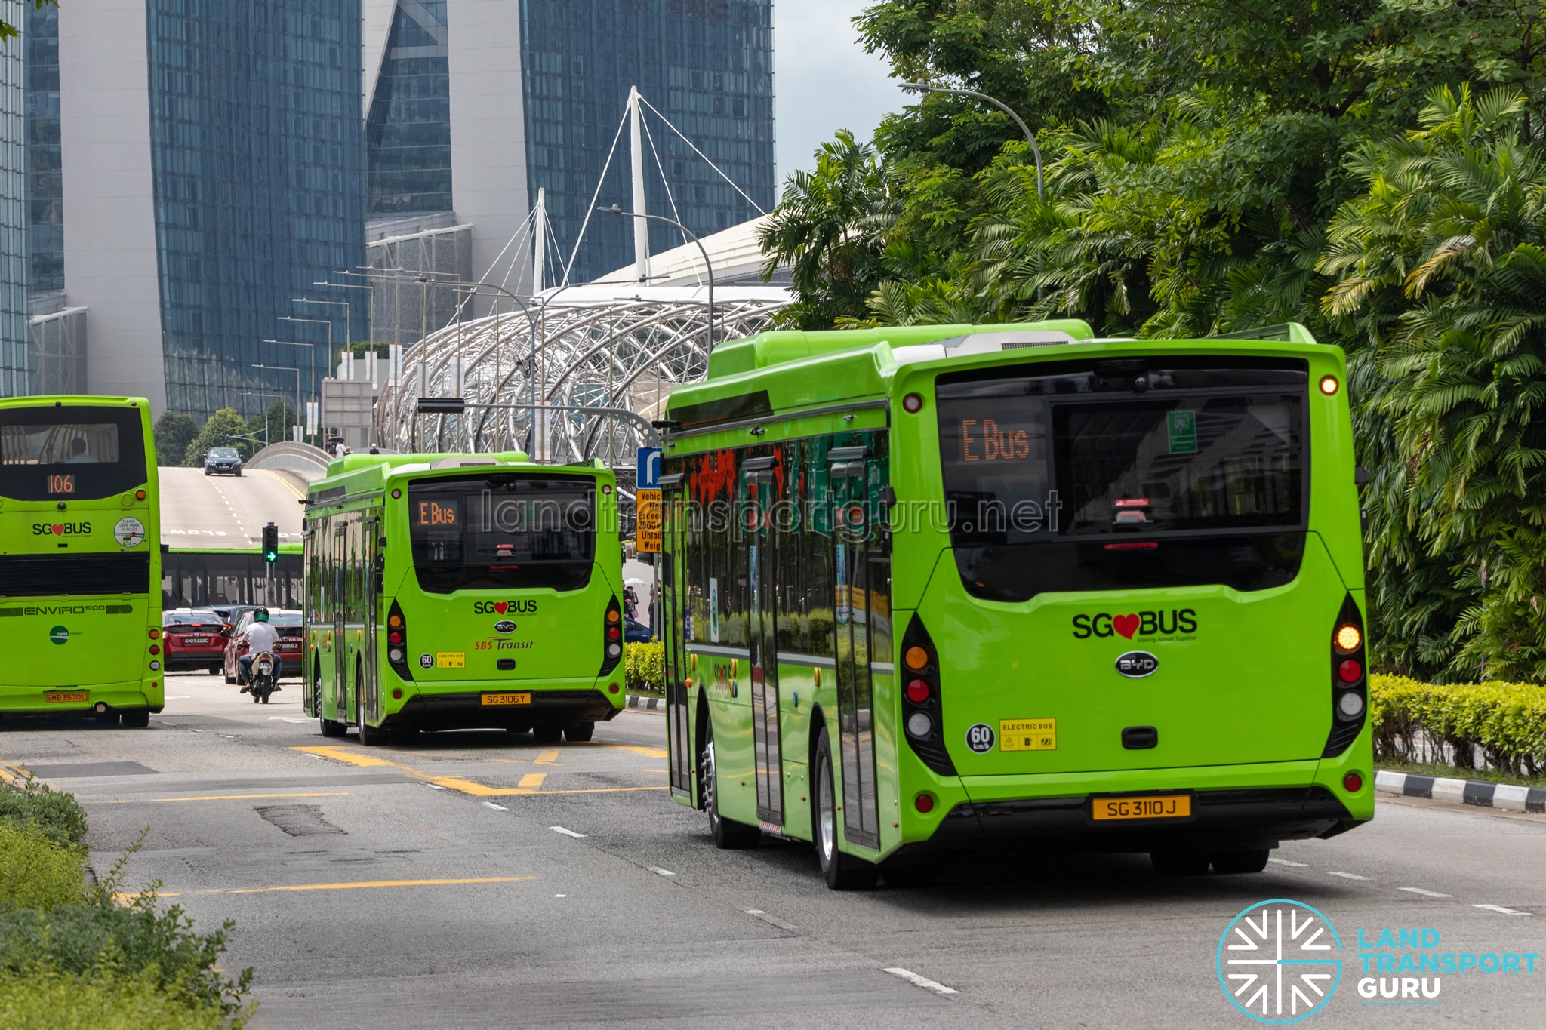
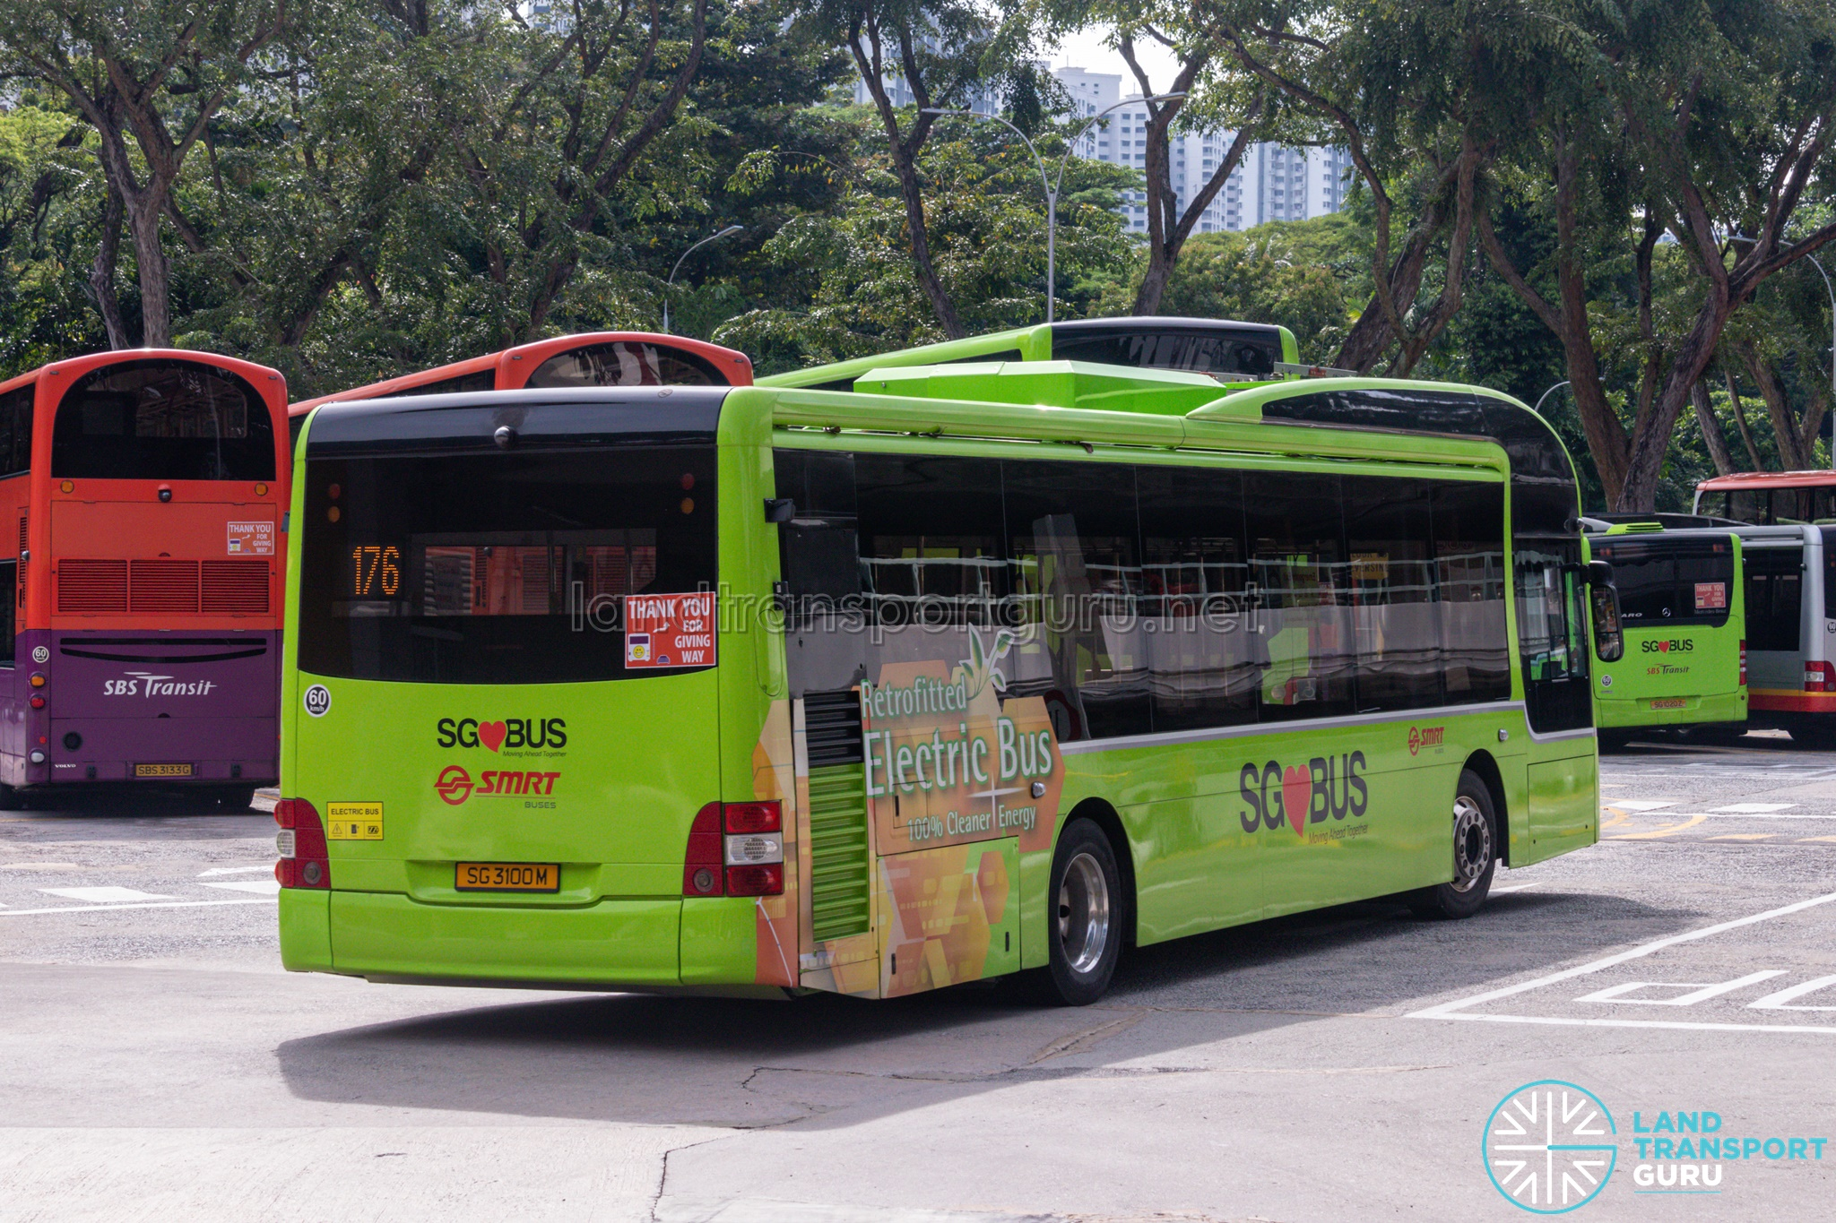
Thank You!!!

Slide 21
Credits
MAN A22 Retrofitted Electric Bus | Land Transport Guru
BYD BC12A04 | Land Transport Guru
Mercedes-Benz Citaro - Singapore
Mercedes-Benz OC500LE | Land Transport Guru
Thankyou For Listening GIFs - Find & Share on GIPHY
Bus Service Prefixes and Suffixes - Singapore
How to Catch the Bus in Singapore | Visitors Guide

